Slide 1
Data Mining and Analysis - 18ECSC301
WEATHER SHIFT PREDICTION.
5DMACP09
TEAM-13
Muskan Havaldar - 01fe19bcs007.
Swathi Pardeshi - 01fe19bcs060.
Srishti Eligar - 01fe19bcs042.
Ankita Mane - 01fe19bcs052.

Slide 2
INTRODUCTION
Prediction is an actual act of indicating that something will happen in the future with or without prior information.
Weather shift prediction is the prediction for long-term alteration of temperature and typical weather patterns in a place.
They have proposed the Shifts Dataset for evaluation of uncertainty estimates and robustness to distributional shift.

Slide 3
MOTIVATION
Weather warnings are important forecasts because they are used to protect life and property.
Since outdoor activities are severely curtailed by heavy rain, snow and wind chill, forecasts can be used to plan activities around these events, and to plan ahead and survive them.
Weather forecasters use all kinds of tools to achieve this goal.

Slide 4
RELATED WORK
Shifts: A Dataset of Real Distributional Shift Across Multiple Large-Scale Tasks
Work done in this paper :
Developing methods for improving robustness to distributional shift and uncertainty estimation.
What is proposed in this paper?
Shifts Dataset for evaluation of uncertainty estimates and robustness to distributional shift
Tasks:
1.Weather shift prediction
2.Machine Translation
3.Self driving cars

Slide 5
PROBLEM STATEMENT
The goal is to predict the temperature at a particular latitude/longitude and time, given all available measurements and climate model predictions.

Slide 6
DATASET DESCRIPTION
TRAIN DATA SET
•Number of Rows: 3129592
•Number of Columns: 129
•Size: 5.03 GB
2. EVAL DATA SET
•Number of Rows: 1137731
•Number of Columns: 123
•Size: 1.71 GB

Slide 7
3. DEV_IN DATA SET
Number of Rows: 50000
Number of Columns: 129
Size: 81.7 MB
4. DEV_OUT DATA SET
Number of Rows: 50000
Number of Columns: 129
Size: 80.2 MB

Slide 8
DATA EXPLORATION

Slide 9
ATTRIBUTE DESCRIPTION
META-DATA
fact_time
fact_latitude
fact_longitude
fact_temperature
fact_cwsm_class
climate

Slide 10
Canadian Meteorological Center(CMC) model : 56 attributes
Weather Research and Forecasting (WRF) model : 13 attributes
Global Forecast system predictions(GFS) : 50 attributes
topography_bathymetry
sun_elevation
climate_temperature
climate_pressure

Slide 11
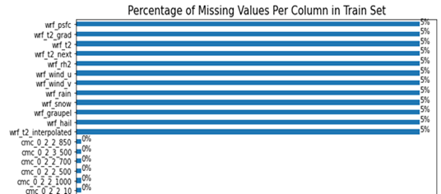
GRAPH 1
Distribution of features having missing values

Slide 12
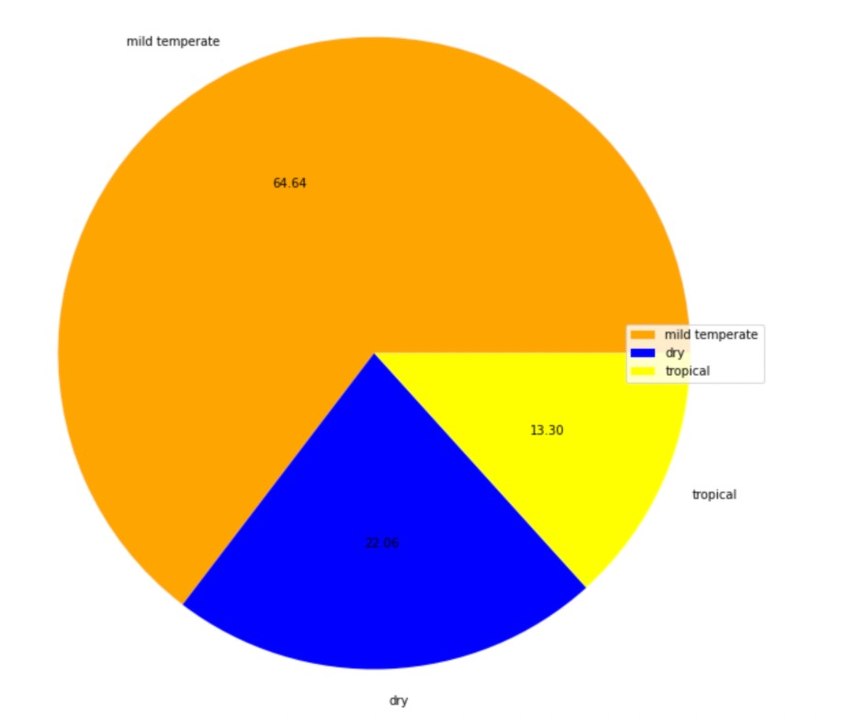
GRAPH 2
Distribution of climatic conditions
1.Mild temperatue(64.64%) – 32 to 35 degrees
2.Dry (22.06%) – 40+ degrees
3. Tropical (13.30) – 18+ degrees

Slide 13
LEARNING MODELS
LINEAR REGRESSION
ELASTIC NET
XGBOOST
CATBOOST

Slide 14
LINEAR REGRESSION MODEL
Multiple linear regression is to model the linear relationship between the explanatory (independent) variables and response (dependent) variables.
➔The dependent variable is temperature.
➔The independent variables are all other columns other than meta data and temperature.
➔RMSE: 2.168

Slide 15
DATA PREPROCESSING (LINEAR REGRESSOR)
Rows containing blank cell are removed.
Columns that do not affect the modeling process majorly are removed.
32% of dataset used(10,00,000 rows x 113 columns)

Slide 16
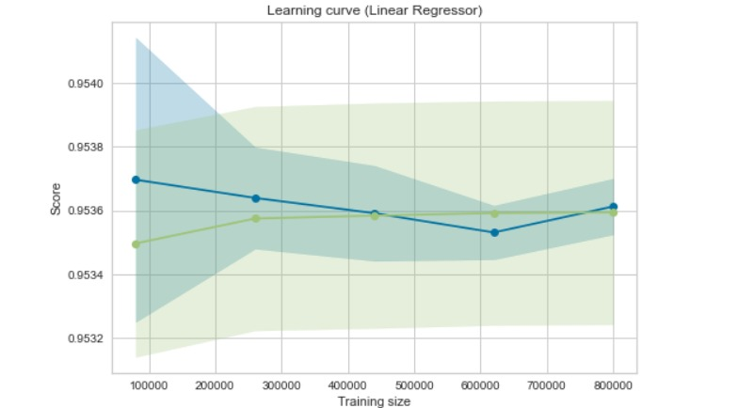
BIAS VARIANCE GRAPH (LINEAR REGRESSOR)

Slide 17
ELASTIC NET MODEL
Elastic net is a popular type of regularized linear regression that combines two popular penalties, specifically the L1 and L2 penalty functions.
➔RMSE: 2.178

Slide 18
Pre-processing (Elastic net model)
Removing rows with missing values
Removing columns
Columns removed: gfs_temperature_(15000….97500)
➔RMSE: 2.178

Slide 19
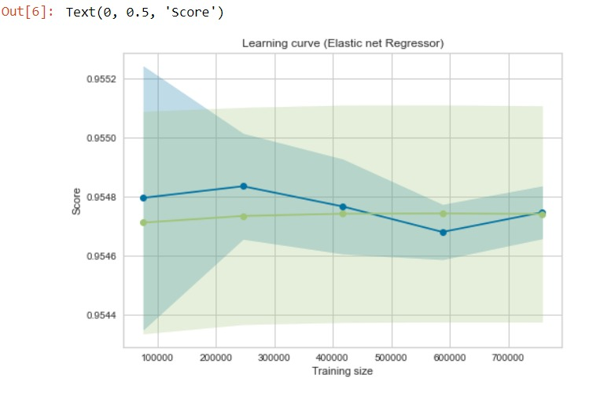
BIAS VARIANCE GRAPH (Elastic net model)

Slide 20
XGBoost
XGBoost is an implementation of gradient boosted decision trees designed for speed and performance.
➔RMSE: 1.978

Slide 21
Pre-processing 1 (XGBoost)
Removing rows with missing values
Removing columns
Columns removed: gfs_temperature_(15000….97500)
Parameters:
colsample_bytree=0.4, gamma=0, learning_rate=0.3, max_depth=6, min_child_weight=1, n_estimators=100, reg_alpha=0.75, reg_lambda=0.45, subsample=0.6, seed=42.
➔RMSE: 1.978

Slide 22
Pre-processing 2 (XGBoost)
Removed metadata column
Filled missing cells with 0
➔RMSE: 4.49

Slide 23
Pre-processing 3 (XGBoost)
Feature selection using F-score
➔RMSE: 1.948

Slide 24
CATBOOST REGRESSOR
CatBoost builds upon the theory of decision trees and gradient boosting.
It introduces ordered boosting as a better gradient boosting algorithm
➔RMSE: 1.9745

Slide 25
Pre-processing (CATBOOST REGRESSOR)
Removed metadata column
Filled missing cells with 0
Parameters:
Iteration=2000
Learning rate = 0.04
➔RMSE: 1.9745

Slide 26
RESULTS
MODEL | RMSE value
LINEAR REGRESSION | 2.168
ELASTIC NET | 2.178
XGBoost | 1.978 and 4.49 and 1.948
CatBoost | 1.9745 and 2.717

Slide 27
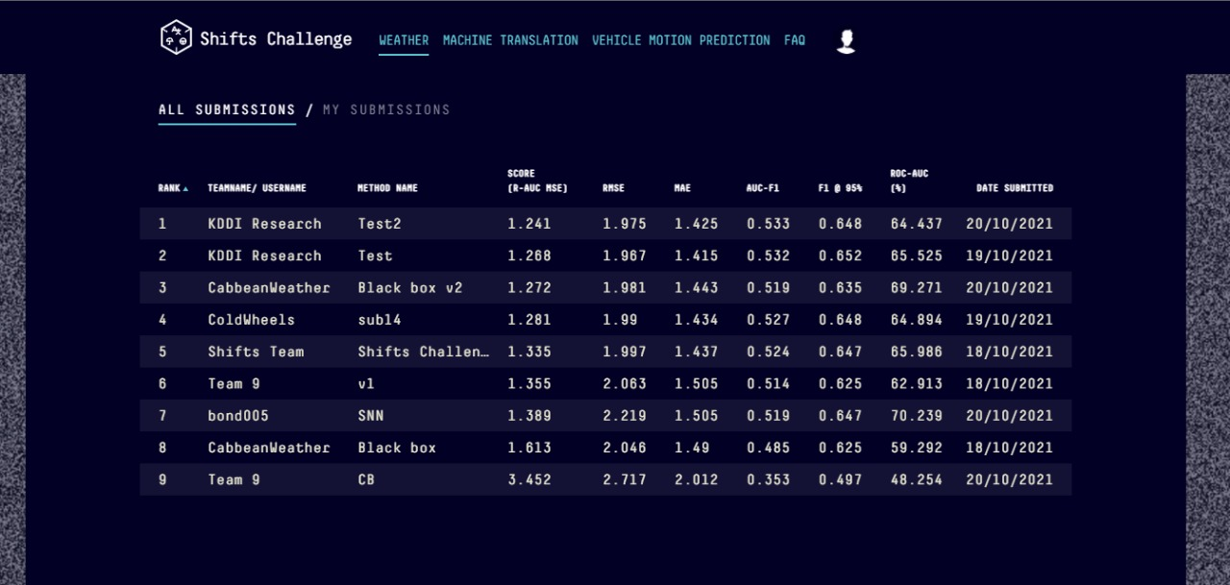
RANKING

Slide 28
CONCLUSION
We aim to build regressor models and using ensemble methods on a large standardised data set for evaluation of uncertainty estimates and robust to realistic, curated distributional shift.
We came across different regressor models and boosting techniques which made us clear which model is fit to our data set.

Slide 29
REFERENCE
Shifts: A Dataset of Real Distributional Shift Across Multiple Large-Scale Tasks (Andrey Malinin, Neil Band, Ganshin, Alexander, German Chesnokov, Yarin Gal, Mark J. F. Gales, Alexey Noskov, Andrey Ploskonosov, Liudmila Prokhorenkova, Ivan Provilkov, Vatsal Raina, Vyas Raina, Roginskiy, Denis, Mariya Shmatova, Panos Tigas, Boris Yangel)
Weather Forecasting Model using Artificial Neural Network (Kumar Abhishek, M.P.Singh, Saswata Ghosh, Abhishek Anand)
An ANN Model Trained on Regional Data in the Prediction of Particular Weather Conditions

